Slide 1
Emergency Preparedness
September 11, 2023

Slide 2
Why prepare a File of Life?
Preparing your vital information ahead of time will allow EMTs and first responders to give you accurate care
A File of Life speaks for you when you may not be able to speak for yourself
Check and update your File of Life at least two times a year

Slide 3
Emergency Contact
Make sure your emergency contacts know that they are your emergency contacts
List one emergency contact that is outside the state in case phone service is affected
Make sure your emergency contacts know your preferred hospital

Slide 4
Medical Data
Use a pencil so that you can easily make changes and updates
Instead of writing out medications, get a print out from your doctor and tuck it in the File of Life holder

Slide 5
Medical Insurance
Make sure your emergency contact knows your insurer
Update this section immediately if your plan changes

Slide 6
What makes a good go bag?
It is ready to go at all times so that when there is an emergency, you can grab it and know that you will have what you need
It is not too heavy
A bag, bucket with a lid, tool box
It is tailored to your particular needs
It is stored in an easily accessible place

Slide 7
What goes in your Go Bag?
3-5 days of nonperishable food and water
Battery or crank operated radio
Flashlight and batteries
3-5 days of medication in a pill box
Roll of toilet paper
First aid kit
Cash
Cell phone charger
Copies of vital documents
Extra clothes and toiletries
File of Life/Medical information
Entertainment – book, crossword puzzle etc…

Slide 8
Car Preparedness
First Aid Kit
Emergency hammer
Reflective triangle
Blankets
Non perishable food
Water

Slide 9
Considerations
Review and update your File of Life twice a year
Check the contents of your go bag at least twice a year to prevent items from expiring
Update any vital documents
If you have multiple people in your household, you each need a go bag.
Always keep half a tank of gas in your car
Let your emergency contact or a loved one know where you keep your go bag

Slide 10
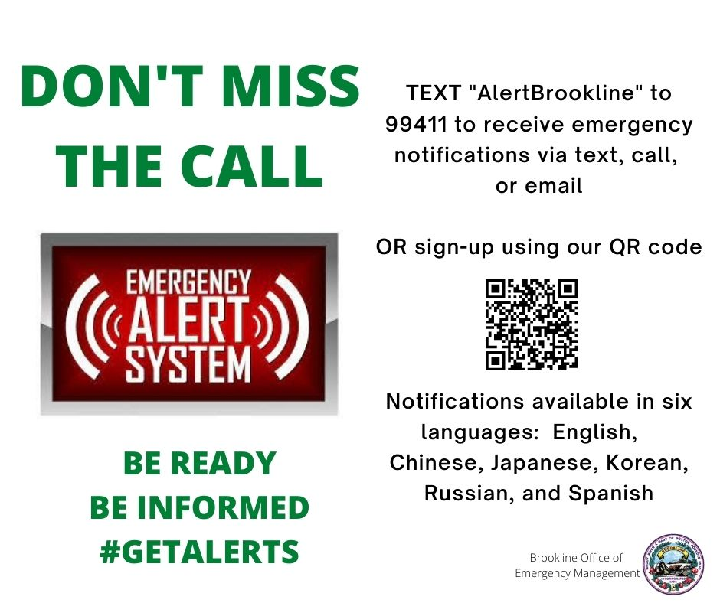

Slide 11
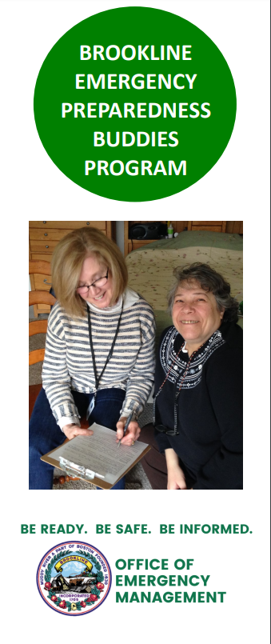
The program was designed as a one-to-one concept matching a Brookline MRC or CERT volunteer with an elder resident “buddy”. Through a series of home-visits, the MRC/CERT volunteer evaluates their buddy’s personal circumstances and provides guidance to help them prepare for emergencies. Elder buddies also receive phone calls ahead of known emergencies, such as heat waves, hurricanes, or blizzards, to remind them to prepare ahead of time.
Contact us if:
You are a Brookline elder or adult with access and/or functional needs wishing one-on-one assistance for your preparedness needs.
You live in a building with access to a community room and would like to organize preparedness sessions through our program. We ask a minimum of 8 participants to schedule a preparedness session.

Slide 12
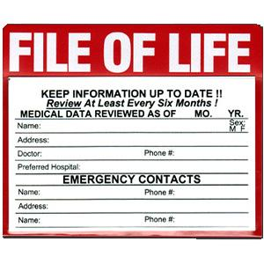
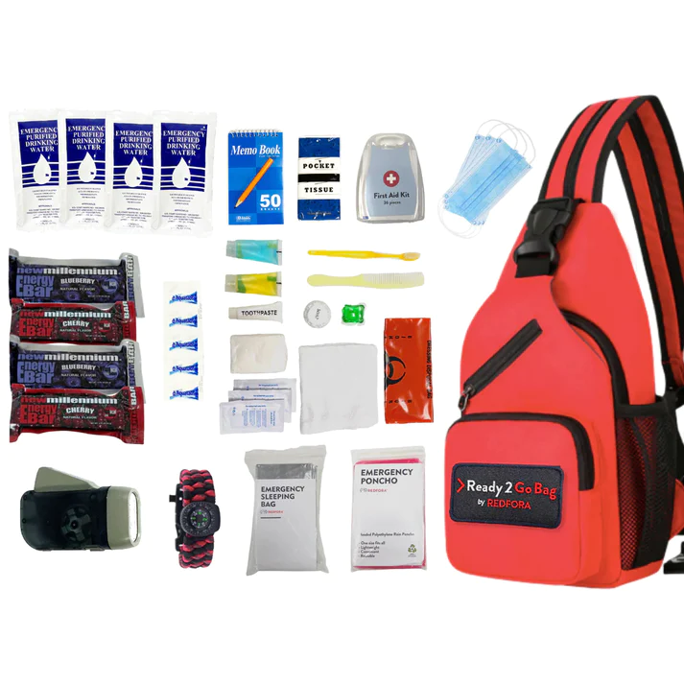
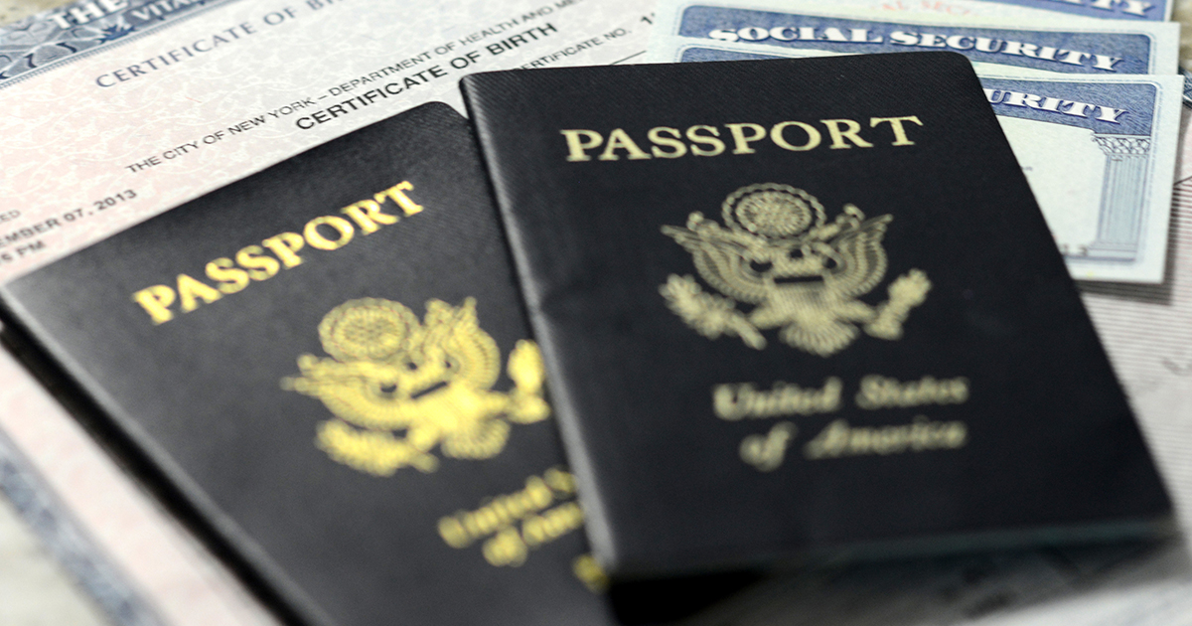
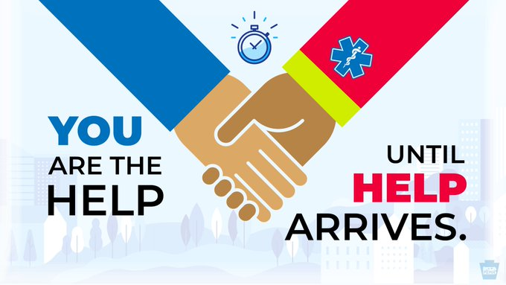
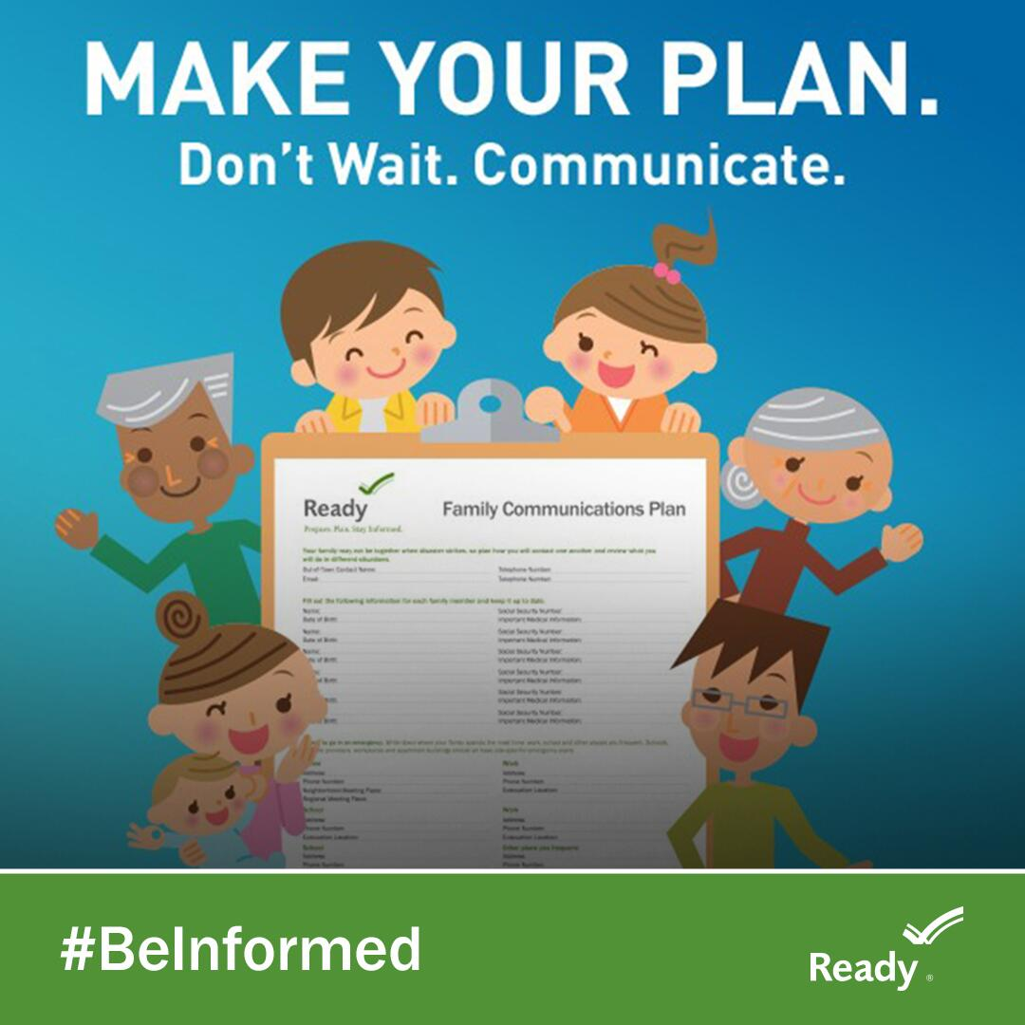
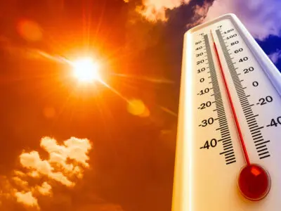
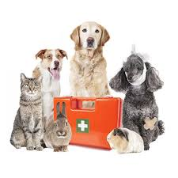
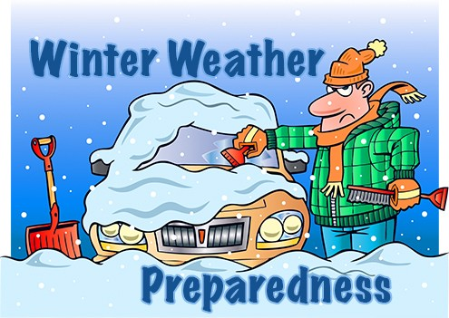
Programming offered by the Town of Brookline
Vital Documents
Go Bag
Summer Preparedness
Pet Preparedness

Slide 13
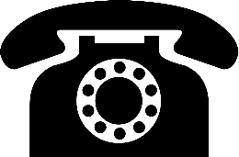
Are you OK?
The "Are You Ok?" program is a daily telephone reassurance program offered by the Norfolk Sheriff’s Office in partnership with Fallon Ambulance.
Each morning, enrolled seniors receive a call to check on their well-being. If an individual fails to respond or requires assistance, staff notifies their family, and if necessary, local police and/or emergency services.
The program is provided 365 days a year for seniors and or people with disabilities. Calls are placed from 6am-10am daily with the time of the call being chosen by the individual. The automated call takes approximately 24 seconds and is monitored by a Norfolk Sheriff Deputy Sheriff or Fallon Ambulance Staff. Individuals may determine how many days a week the call is placed and may suspend calls when they know they will be away from home. The monitoring of these calls is a great tool in determining the needs of an individual while at the same time allowing elderly residents living alone to have a sense of security knowing that a public safety professional is checking on their well-being.
Seniors interested in signing up for this no cost, potentially lifesaving, program are encouraged to contact 1-866-900-7865.

Slide 14

The Yellow Dot Program
Yellow Dot is a free program which provides first responders with quick access to critical medical information about the occupants of an automobile in the event of an accident or health emergency.
Participants place a Yellow Dot Decal on the driver’s side rear windshield of their cars. In the event of an emergency or accident, the Yellow Dot alerts emergency responders that inside the glove compartment there is an envelope containing the operator’s medical information inside the car’s glove compartment. The envelope has the operator’s medical conditions, allergies, recent surgeries, medications and emergency contact information.
For more information or to sign up please contact the Norfolk Sheriff’s Office Senior Programs Division at 781-751-3300.

Slide 15
Contact us:
Sara Schaffer, Emergency Preparedness Coordinator
Brookline Department of Public Health and Human Services
617-730-2333
sschaffer@BrooklineMA.gov
Sophie Gordon, Emergency Preparedness Buddies Program Coordinator
Brookline Office of Emergency Management
617-730-2304
sgordon@BrooklineMA.gov

